Slide 1

Predicting
Camera review
Ratings on

Slide 2
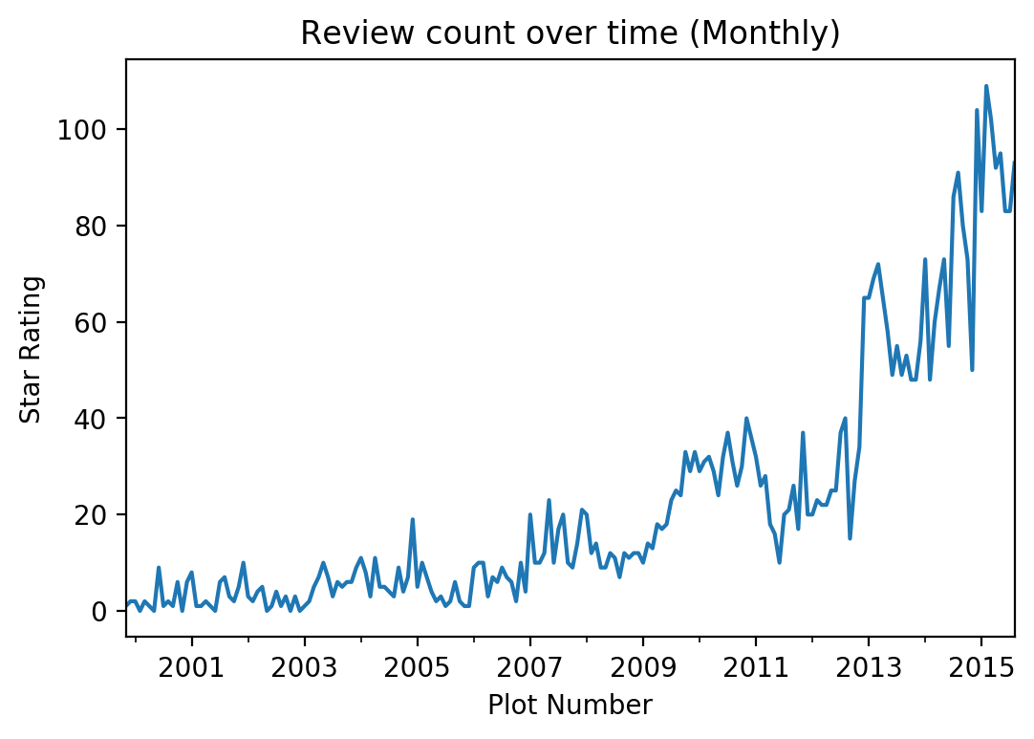
Please leave a review..
Notes:
How many reviews or feedback did you leave in the last week?
Review growth and influence are growing

Slide 3
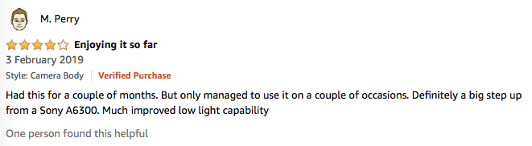
Review’s provide
customer insight

Slide 4
Reviews drive purchase decisions
1
Contextual usage information
2
Reduce risk: validate manufacturer claims
3
Understand consumer needs (met and unmet)
Notes:
High ratings on Amazons algorithm more likelyhood of search impressions

Slide 5

Potential
Audience
Product developers and marketeers seeking understanding of the digital camera market through reviewer behaviour and identifcation of unmet needs.

Slide 6
Goals
Identify camera features that lead to good or bad experiences
Predict the product rating better than baseline score 0.713

Slide 7

Dataset
A collection of reviews written in the Amazon.com marketplace and associated metadata from 1995 until 2015.
(130M+ customer reviews)
Tab Separated .TSV
Web Scraping
https://registry.opendata.aws/amazon-reviews/
Notes:
The UK dataset was not viable as it was much smaller for observations in the Camera category (6427 before cleaning,30 afterwards)

Slide 8
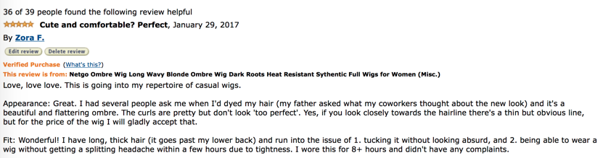
Features
Marketplace
customer_id
review_id
product_id
product_parent
product_title
product_category
star_rating
helpful_votes
total votes
vine
verified_purchase
review_headline
review_body
review_date
Dataset Features
Notes:
2 letter country code of the marketplace where the review was written.
Random identifier that can be used to aggregate reviews written by a single author.
The unique ID of the review.
The unique Product ID the review pertains to.
Random identifier that can be used to aggregate reviews for the same product.
Title of the product.
Broad product category that can be used to group reviews
The 1-5 star rating of the review.
Number of helpful votes.
Number of total votes the review received.
Review was written as part of the Vine program.
The review is on a verified purchase.
The title of the review.
The review text.
The date the review was written.

Slide 9
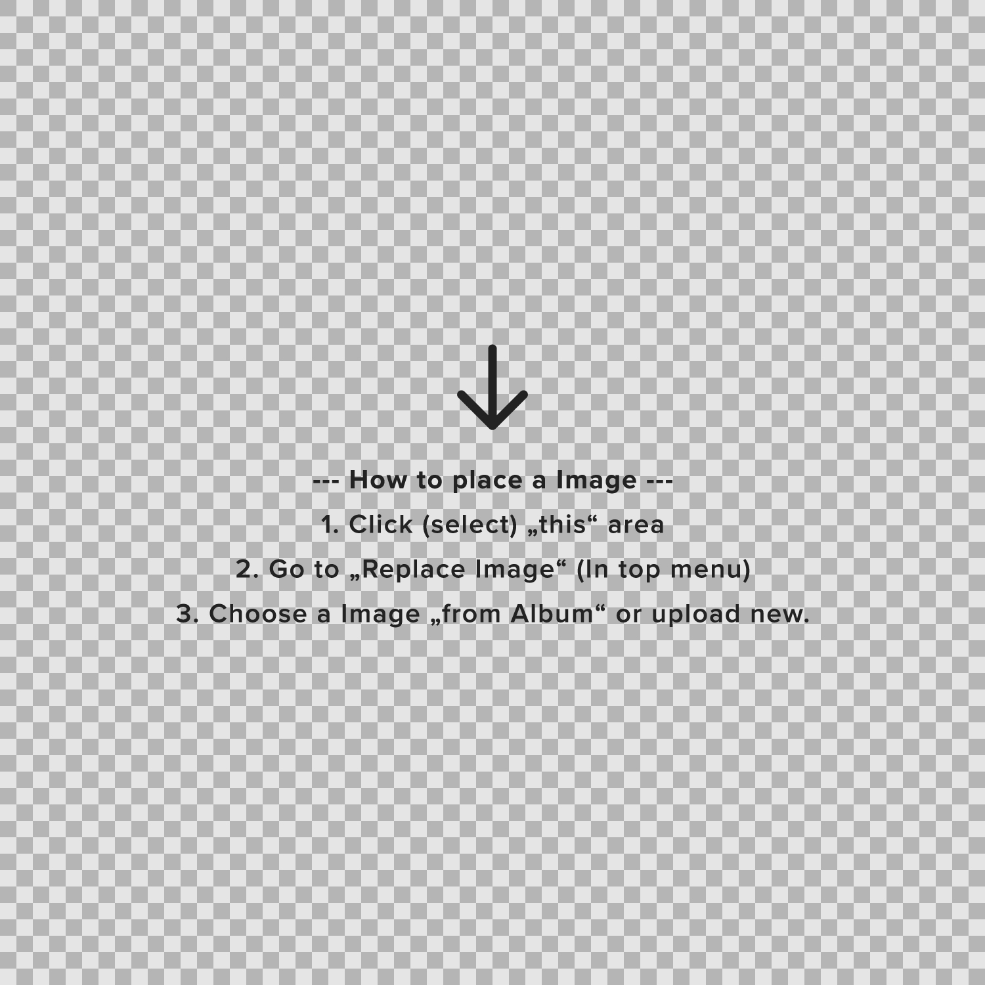

Features
Marketplace
customer_id
review_id
product_id
product_parent
product_title
product_category
star_rating
helpful_votes
total votes
vine
verified_purchase
review_headline
review_body
review_date
Process (pt 1)
Import
and cleaning
Feature Engineering
EDA
Notes:
2 letter country code of the marketplace where the review was written.
Random identifier that can be used to aggregate reviews written by a single author.
The unique ID of the review.
The unique Product ID the review pertains to.
Random identifier that can be used to aggregate reviews for the same product.
Title of the product.
Broad product category that can be used to group reviews
The 1-5 star rating of the review.
Number of helpful votes.
Number of total votes the review received.
Review was written as part of the Vine program.
The review is on a verified purchase.
The title of the review.
The review text.
The date the review was written.

Slide 10
Features
Marketplace
customer_id
review_id
product_id
product_parent
product_title
product_category
star_rating
helpful_votes
total votes
vine
verified_purchase
review_headline
review_body
review_date
Process (pt 2)
Modelling
Results
Key takeaways &
improvements

Slide 11

Technology List
Python
This project using Python-3.6 environment
Numpy
The fundamental package for scientific computing with Python
Sci-kit Learn
Simple and efficient package for data mining and data analysis. Feature extraction using Count Vectoriser and Tfidf vectoriser.
Pandas
Easy-to-use data structures and data analysis tools for Python
Selenium & Beastiful Soup
Automated browser to scrape information. Convert web page to xml so that all infomation on that page can be accessed easily
Vader Sentiment
lexicon and rule-based sentiment analysis tool
Imbalanced Learn
A package offering a number of re-sampling techniques commonly used in datasets showing strong between-class imbalance
Textacy
Python library for performing a variety of Natural Language Processing (NLP tasks)

Slide 12
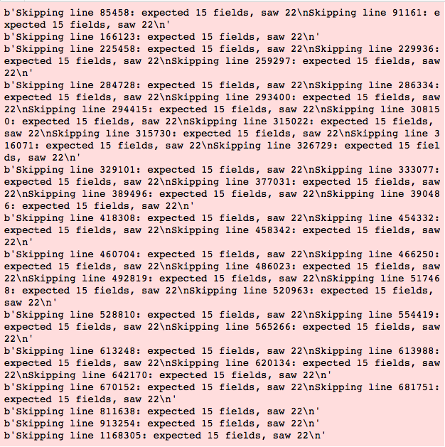
Importing

Slide 13
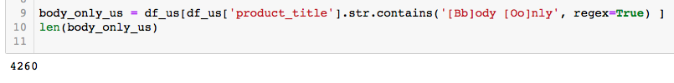
Data cleaning:
Finding only cameras
Removing columns: [Marketplace, Product Category, Vine]
No missing values
No duplicated reviews
Data types (Review Date) to datetime
Investigated outliers for numerical variables
Notes:
Filtering on cameras

Slide 14
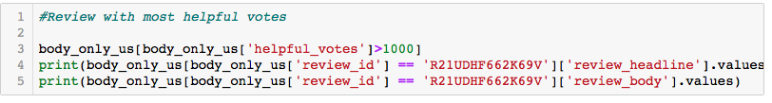
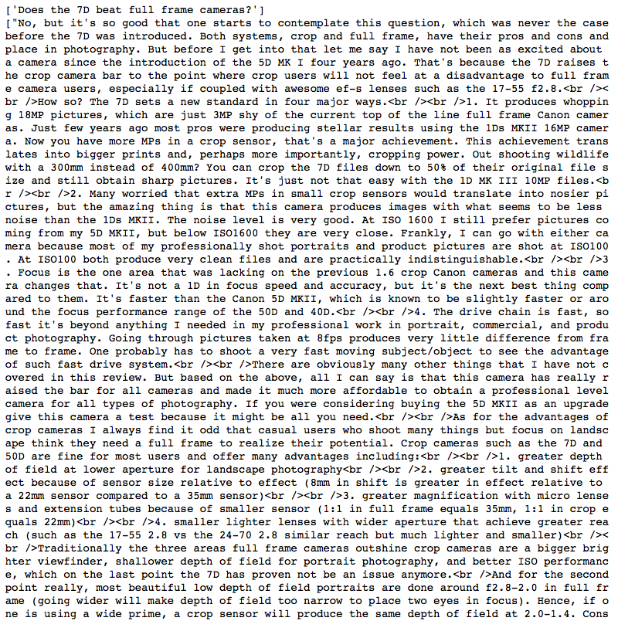
Most helpful review (outlier)

Slide 15
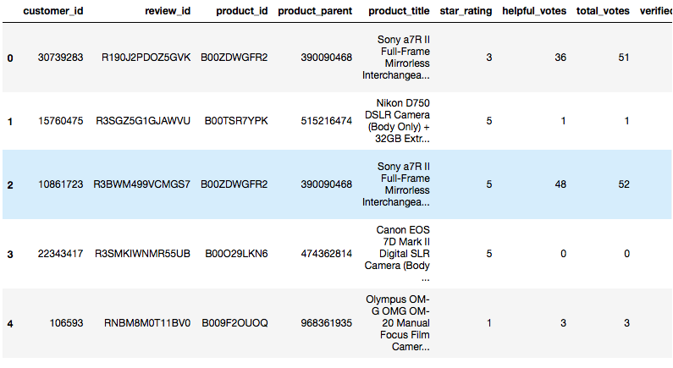
Remaining:
4260 reviews (headline and body)
397 Total unique products.

Slide 16
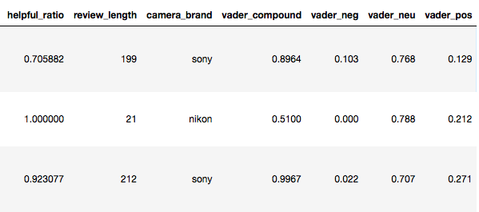
Feature engineering
helpful_ratio - Helpful votes : Total votes (fillna: mean)
review_length - Word count of review body
camera_brand - Extracted from product title. Regrouped.
VADER scores – Sentiment scores or each review
☹️🤔😀
Notes:
positive sentiment: compound score >= 0.05
neutral sentiment: (compound score > -0.05) and (compound score < 0.05)
negative sentiment: compound score <= -0.05

Slide 17
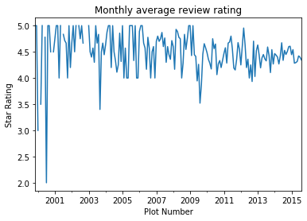
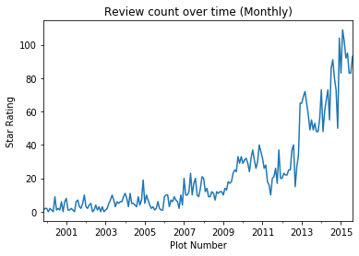
EDA: Time trends
Notes:
Average review rating is high between 4-5 only dips on certain months.
Review counts increase over the years

Slide 18
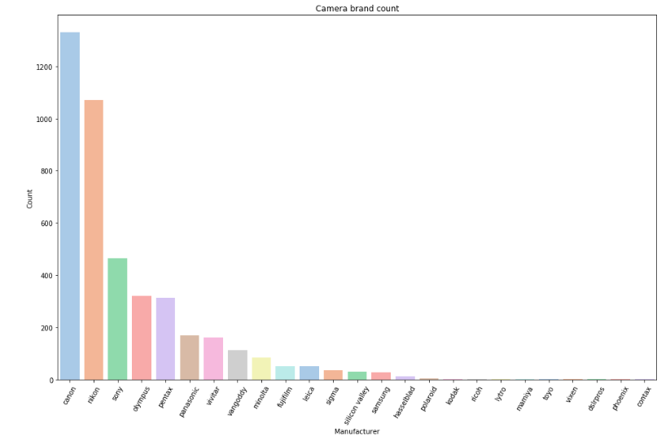
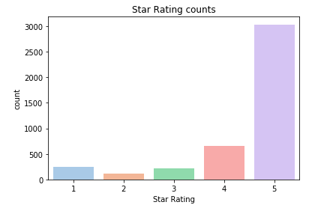
EDA: ratings, and brand counts
Brand average ratings
Canon 4.534586
Nikon 4.545709
Sony 4.496774
Vivitar 2.493827
Polaroid 2.200000
Notes:
Rating counts and brand counts
Mean star rating is 4.43 stars. Mostly positive reviews with 4 and 5 star ratings. Class imbalance in the data.
Class imbalance! Questioning accuracy as the metric!
Conventional algorithms are often biased towards the majority class, not taking the data distribution into consideration. In the worst case, minority classes are treated as outliers and ignored. For some cases, such as fraud detection or cancer prediction, we would need to carefully configure our model or artificially balance the dataset, for example by undersampling or oversampling each class.

Slide 19
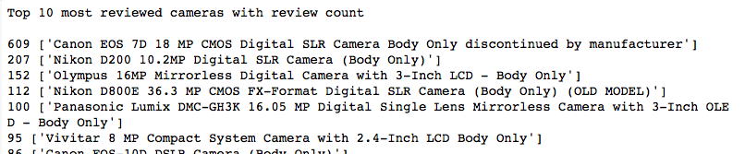
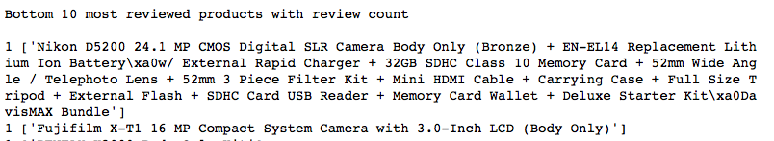
EDA: Most and least reviewed

Slide 20
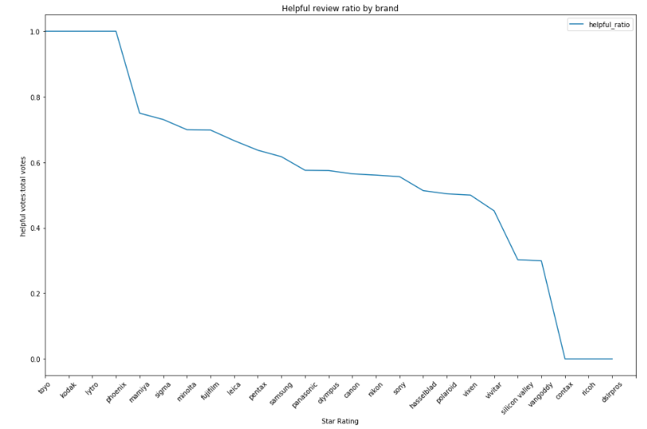
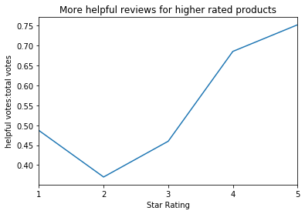
EDA: Helpful ratio
Notes:
Helpfulness
Metric used to give weight to certain reviews or quality to a prospective buyer.
On average there are 8.9 helpful votes per review with a Median of 2. One review had over 1310 helpful votes! which i display in my notebook.
The five most helpful reviews were all longer than the mean review length (190) and median (85) - [1800,1507,579,513,301]
On average more helpful reviews were left for ratings 5, 4 and 1.
star_rating (average helpfulness)
1 0.486704
2 0.369964
3 0.459751
4 0.685411
5 0.752291

Slide 21
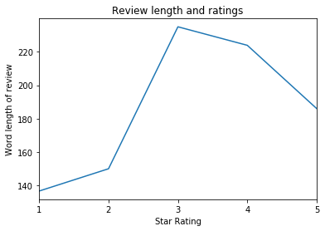
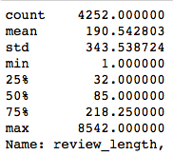
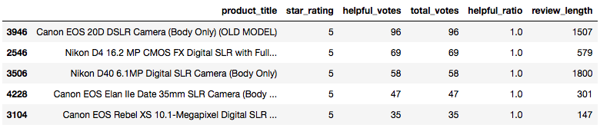
EDA: Review length
Notes:
Most helpful reviews how long are they?
One review had 1357 total votes. It was long with a good title.

Slide 22
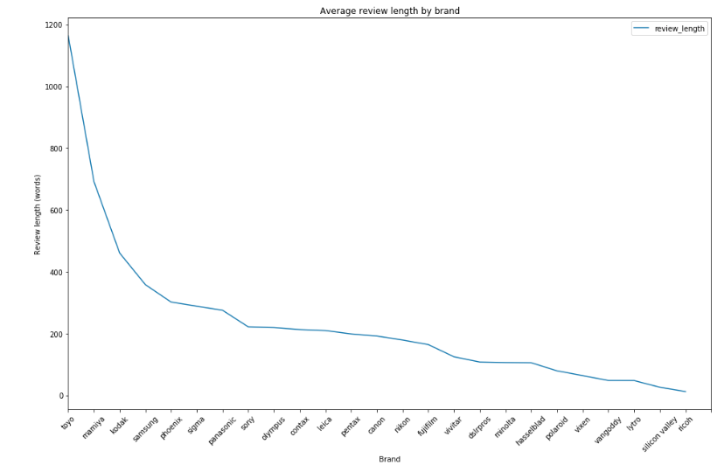
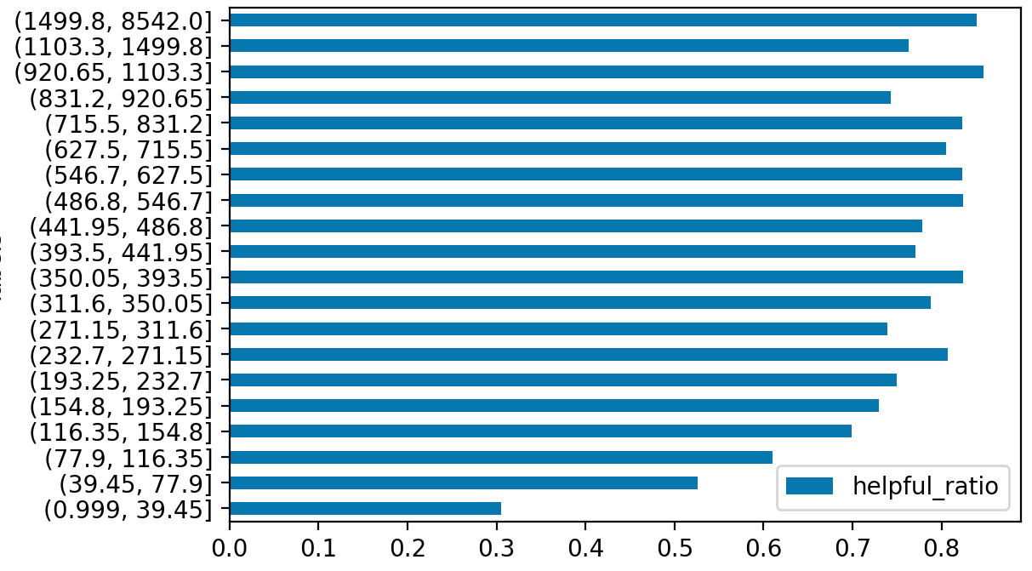
EDA: Review length
Review length helpfulness ratio
Word count
Notes:
Most helpful reviews how long are they?
One review had 1357 total votes. It was long with a good title.

Slide 23
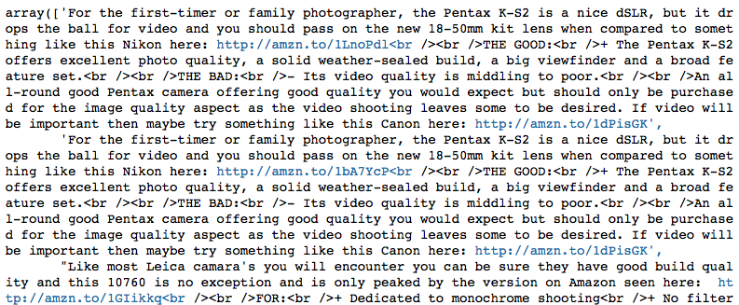
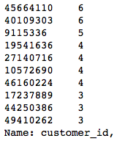
EDA: Reviewer behaviour
Notes:
Reviewers
Repeat reviewers.
A handful of users gave multiple reviews in this sample. Two users gave 6 reviews.
Found some affiliate spam looking reviews by the most frequent reviewer.
Reviewers who write alot tend to have a high helpful ratio.

Slide 24
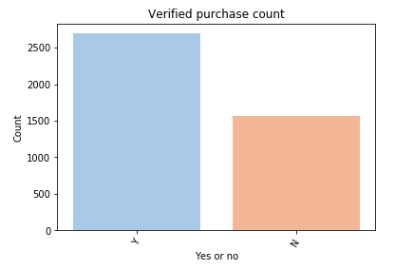
EDA: Verified purchases
Notes:
Problems – show most frequent reviewer

Slide 25
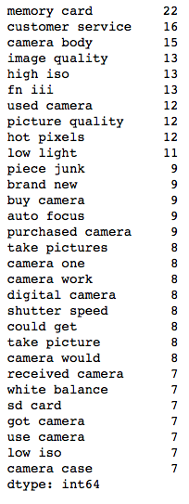
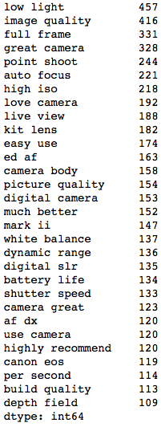
EDA: text features
One star reviews
Five star reviews
Notes:
Popular words and ngram range
Most popular words in 5 star reviews and 1

Slide 26
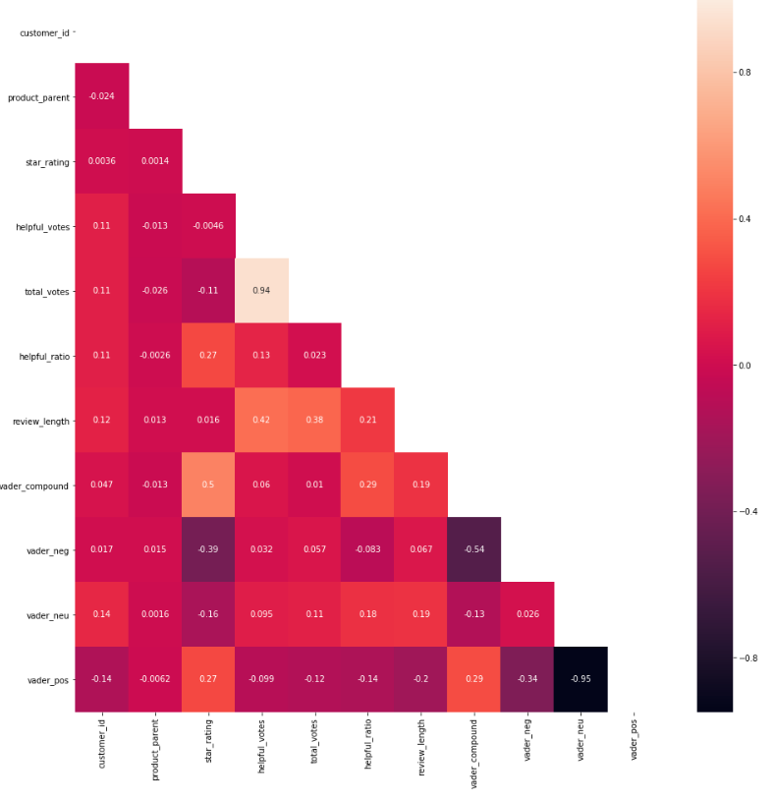
Heatmap
Notes:
Correlation heat map:
shows that helpful_ratio has some positive explanatory power (0.27) to the star rating.
Vader negative as expected -0.39
Vader compound has the most correlation with star rating at 0.5

Slide 27

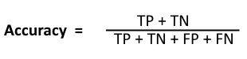
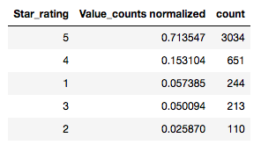
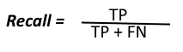
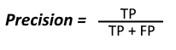
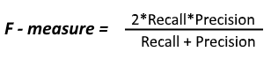
Success Metrics
Model that performs above the baseline accuracy 0.713.
F1 score, Precision, Recall, F1.
Notes:
One of my setbacks I encountered is after scraping current Amazon products “total votes” is no longer shown on the website. Therefore I can’t construct another helpful ratio for new current cameras. On the other hand I can also scrape pricing data.
The risks in this dataset are that the review body is very large and computing power will be a limitation. Also accuracy will be difficult to predict 5 classes of ratings. Potentially it would have been easier to predict positive or negative. Skewed data

Slide 28
Model: single feature [review body]
 | Logreg CVEC | Logreg TFIDF | MN NaiveBayes | Random Forest | Gradient Boost | KNN | SVM
precision | 0.647411 | 0.652059 | 0.618355 | 0.588417 | 0.548345 | 0.587785 | 0.687722
recall | 0.710815 | 0.700627 | 0.713950 | 0.702978 | 0.713950 | 0.710031 | 0.651254
f1-score | 0.673710 | 0.674320 | 0.597667 | 0.615236 | 0.597588 | 0.608114 | 0.664229
support | 1276.000000 | 1276.000000 | 1276.000000 | 1276.000000 | 1276.000000 | 1276.000000 | 1276.000000
Cross_val training score | 0.707660 | 0.714046 | 0.714048 | 0.699272 | 0.713374 | 0.704303 | 0.643136
test score | 0.710815 | 0.700627 | 0.713950 | 0.702978 | 0.713950 | 0.710031 | 0.651254
Notes:
Naïve bayes has the highest accuracy scores. But that’s not the whole story

Slide 29
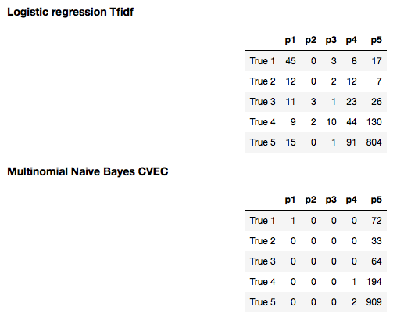
F1 vs accuracy
Although the multinomial Naïve Bayes Classifier
had the highest cross validation and test accuracy scores. You can see that it predicted 5* nearly every time. This is a problem in imbalanced datasets.
Logistic regression on the other hand had the greatest F1 score which is a weighted average of precision and recall. You can see it has a greater spread of predictions and more correct classifications of the minority classes.
Going forward F1 will be the primary metric of comparison.

Slide 30
Model: multiple feature’s
Features used :
helpful_ratio
review_length
vader_pos
vader_neg
camera_brand
verified_purchase
review_body
Notes:
Features: ['helpful_ratio','verified_purchase','review_body','review_length','camera_brand','vader_compound','vader_pos','vader_neu','vader_neg']

Slide 31
Model: multiple feature’s TFIDF
 | KNN | SVC | Logreg | RandForest | GradBoost | MultinomialNB
precision | 0.610031 | 0.691934 | 0.649611 | 0.576510 | 0.652488 | 0.509724
recall | 0.695925 | 0.706113 | 0.719436 | 0.710031 | 0.728056 | 0.713950
f1-score | 0.643642 | 0.697820 | 0.669140 | 0.617243 | 0.631536 | 0.594795
support | 1276.000000 | 1276.000000 | 1276.000000 | 1276.000000 | 1276.000000 | 1276.000000
cross_val training score | 0.704979 | 0.694901 | 0.722777 | 0.709691 | 0.733201 | 0.714720
test score | 0.695925 | 0.706113 | 0.719436 | 0.710031 | 0.728056 | 0.713950
Notes:
Gradient boosting has the highest accuracy score. But hold on a minute!
SVC highest F1 score
Checking the confusion matrix

Slide 32
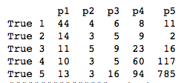
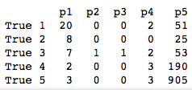
F1 vs accuracy: again
Similarly to the single feature model. The Gradient Boosting classifier has a higher accuracy score. Predicting primarily 5* though also some 1* predictions.
SVC on the other hand has a greater F1 score and at a cost of accuracy correctly predicts across 2,3 4* classes.
SVC TFIDF
Gradient Boost
TFIDF

Slide 33
Model: multiple features w/ Count Vectoriser
 | KNN | SVC | Logreg | RandForest | GradBoost | MultinomialNB
precision | 0.596557 | 0.629360 | 0.658725 | 0.588333 | 0.570702 | 0.613339
recall | 0.705329 | 0.666144 | 0.735110 | 0.709248 | 0.724138 | 0.727273
f1-score | 0.623883 | 0.645660 | 0.686371 | 0.609829 | 0.626816 | 0.642532
support | 1276.000000 | 1276.000000 | 1276.000000 | 1276.000000 | 1276.000000 | 1276.000000
cross_val training score | 0.710002 | 0.689562 | 0.735233 | 0.709342 | 0.734883 | 0.723452
test score | 0.705329 | 0.666144 | 0.735110 | 0.709248 | 0.724138 | 0.727273
Notes:
Logistic Regression

Slide 34
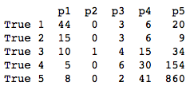
Models with highest F1 score
SVC Tfidf Vectoriser (0.697820)
Logistic Regression CVEC (0.686371)
SVC TFIDF
Logistic
Regression
CVEC
Logistic regression is making larger errors at prediction of 1* for true 5* reviews and vice versa.

Slide 35
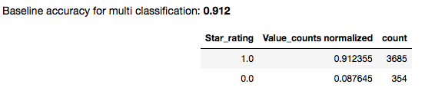
Spread of predictions is limited. Let’s try high or low.
Predicting high or low star rating
Creating a new column in the dataset 'binary rating' with the following assigned depending on the star rating.
Low: 1 and 2
High: 4 and 5
The same class imbalance is present which has so far been accounted for using class_weights = balanced. As a hyperparameter and using F1 as the performance metric.

Slide 36
Model: Binary problem w/ Count Vectoriser
 | KNN | SVC | Logreg | RandForest | GradBoost | MultinomialNB
precision | 0.888478 | 0.937927 | 0.952023 | 0.920469 | 0.931145 | 0.934784
recall | 0.914191 | 0.938944 | 0.952970 | 0.920792 | 0.931518 | 0.938119
f1-score | 0.888662 | 0.938412 | 0.952455 | 0.890858 | 0.912360 | 0.925321
support | 1212.000000 | 1212.000000 | 1212.000000 | 1212.000000 | 1212.000000 | 1212.000000
cross_val training score | 0.921825 | 0.934553 | 0.944815 | 0.918288 | 0.926066 | 0.928197
test score | 0.914191 | 0.938944 | 0.952970 | 0.920792 | 0.931518 | 0.938119

Slide 37
Model: Binary problem w/ TFIDF
 | KNN | SVC | Logreg | RandForest | GradBoost | MultinomialNB
precision | 0.925095 | 0.946223 | 0.937891 | 0.921289 | 0.932601 | 0.832732
recall | 0.932343 | 0.948845 | 0.915017 | 0.929868 | 0.930693 | 0.912541
f1-score | 0.927220 | 0.947197 | 0.923103 | 0.914009 | 0.910073 | 0.870812
support | 1212.000000 | 1212.000000 | 1212.000000 | 1212.000000 | 1212.000000 | 1212.000000
cross_val training score | 0.927490 | 0.943758 | 0.916166 | 0.920409 | 0.927127 | 0.912275
test score | 0.932343 | 0.948845 | 0.915017 | 0.929868 | 0.930693 | 0.912541
Notes:
Gradient Boosting

Slide 38
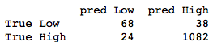
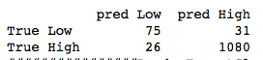
Binary Classification: Highest F1 score
Again the same two models as the multi classification model had the highest F1 scores.
SVC Tfidf Vectoriser (0.947197)
Logistic Regression CVEC (0.952455)
SVC TFIDF
Logistic
Regression
CVEC
Overall the Logistic Regression model made fewer errors. With fewer False Positives, Though two more False negatives.

Slide 39
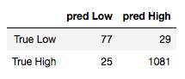
Resampling
In an imbalanced dataset there is more likelihood of predicting the majority class to improve accuracy.
Resampling methods such as under sampling, over sampling or generating synthetic samples were trialled.
The best results were from removing Tomeklinks with the logistic regression model with a small improvement in both accuracy and F1 scores.
Logistic
Regression
CVEC
Logistic
Regression
CVEC
With Tomeklinks
resampling

Slide 40
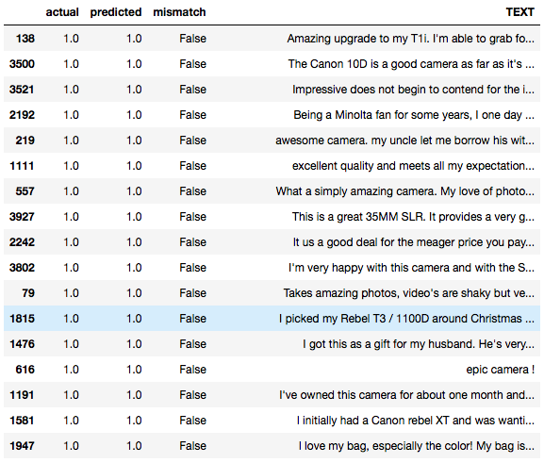
Misclassified results
Themes emerging from misclassified reviews:
True low / predicted high
- Excited at first but then disappointed.
- Satisfied with camera but an important downside (price, warranty or customer service)
True high / predicted low
- Big problem that was resolved. e.g replacement camera
- Similarly to above, satisfied with results but experienced a difficulty
- 'No complaints' terms like this.
Some words that may have give a negative sentiment emotionally but had low reviews.
- Technical errors e.g motion stutter
- Product experience: Unusable, defect, unreliable
- Return e.g sent back to seller

Slide 41
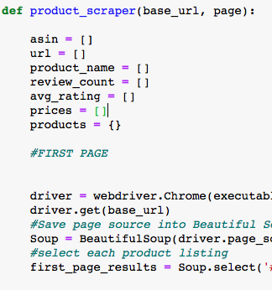
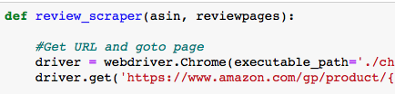

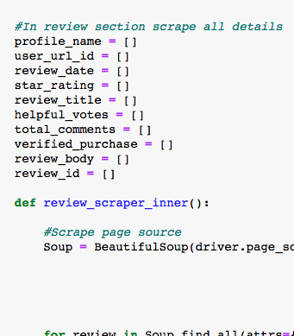
Scraping current reviews (investigating class imbalance)

Slide 42
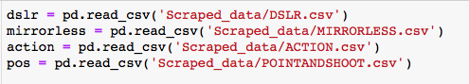
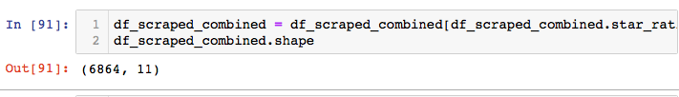
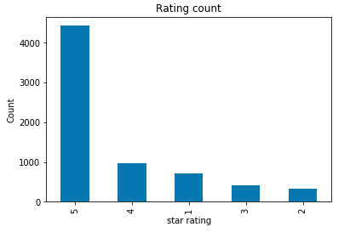
Web Scraping (6864 recent reviews)
Notes:
Data stil imbalanced. That’s just how Amazon is, perhaps because their aim is to sell after all!

Slide 43
Key takeaways:
Prioritise features: low light, image quality, full frame, auto focus in new cameras
Focus on fixing: memory card, customer service, camera body, image quality, high iso
Amazon reviews are skewed towards high ratings.
F1 is a more suitable metric in multi class problem due to the class imbalance.
Binary predictor performs fairly well: 0.9551 F1 score and 0.9554 accuracy score. Greater than the baseline of 0.912.

Slide 44
Limitations:
Further parameter tuning required
Text features are noisy. Further preprocessing like sentence stemming possible.
Class Imbalance in data
How legitamate are non-verified reviews? Did they actually purchase?

Slide 45
Next Steps:
Further feature engineering
Consider multiple camera types and price points on scraped dataset

Slide 46
Thank you.

